Slide 1


Scientific Machine Learning
Lecture 17: Transformer
孟旭辉
数学与统计学院数学与应用学科交叉创新研究院
办公室：欣苑2栋111室
Email：xuhui_meng@hust.edu.cn
https://github.com/XuhuiM/SciML-Course

Slide 2
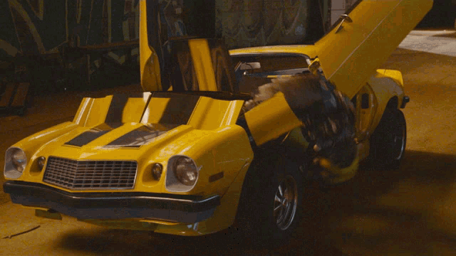

Transformer

Slide 3
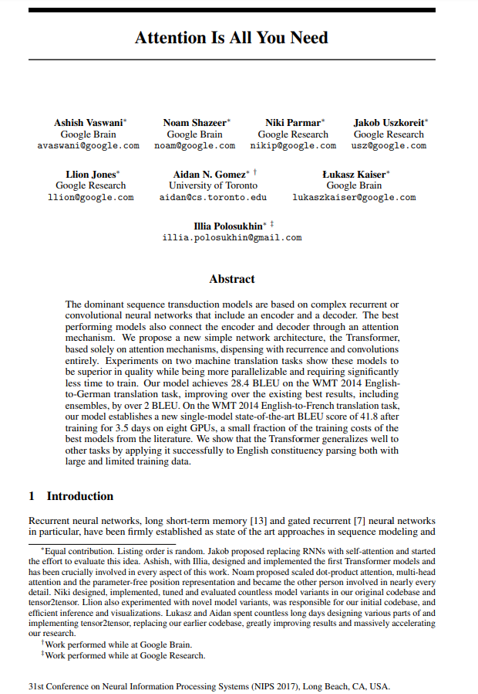

Transformer

Slide 4
Emergent ability in LLMs
An ability is emergent if it is not present in smaller models but is present in larger models
Model scale
Wei, et al., Machine Learning Research, 2022

Slide 5
In-context learning in LLMs
LLMs are able to in-context learn—perform a new task via inference alone by conditioning on a few input label pairs (demonstrations) and making predictions for new inputs.
Min, et al., arxiv, 2022

Slide 6
In-context learning in LLMs
LLMs are able to in-context learn—perform a new task via inference alone by conditioning on a few input label pairs (demonstrations) and making predictions for new inputs.
Min, et al., arxiv, 2022

Slide 7

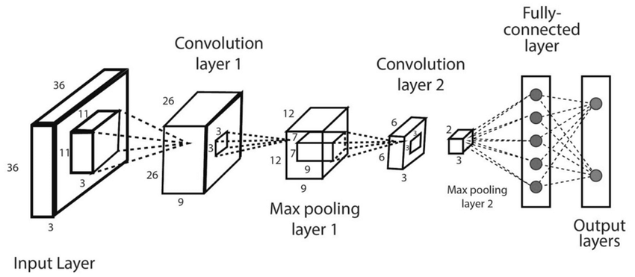
Transformer
Vaswani et al. Neurips, 2017

Slide 8
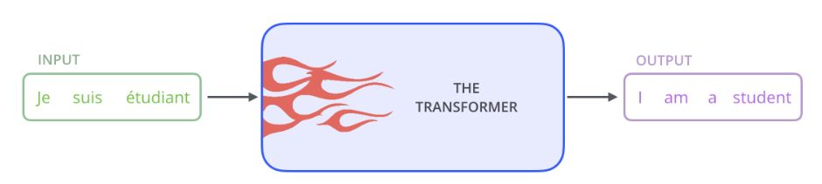
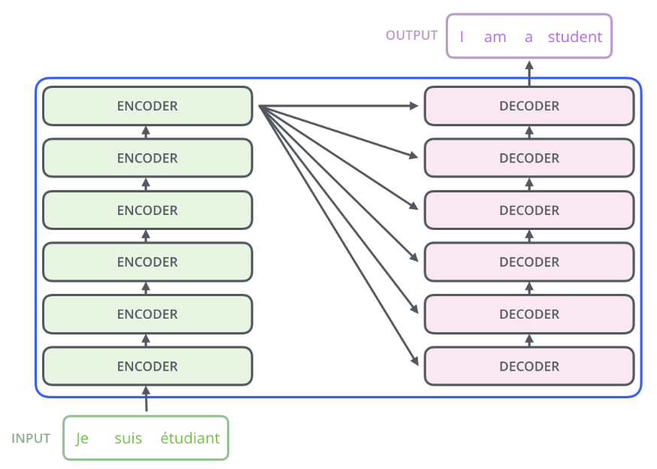
Transformer
Blog of Alammar

Slide 9
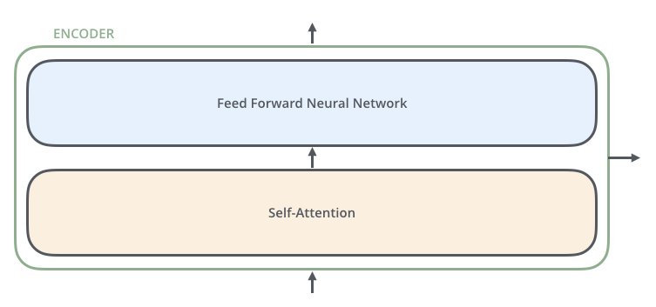
Transformer
Blog of Alammar

Slide 10
Transformer
Blog of Alammar

Slide 11
Transformer: Encoder
Blog of Alammar

Slide 12
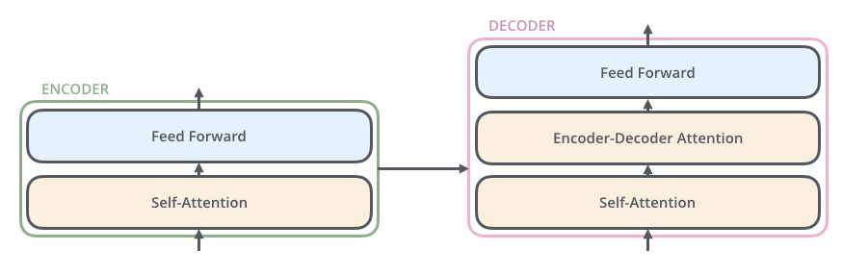
Transformer: Decoder
Blog of Alammar

Slide 13
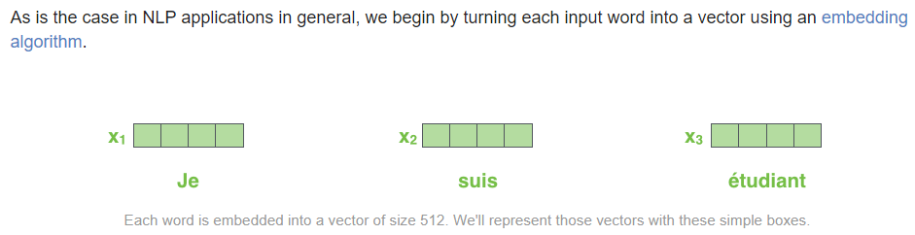
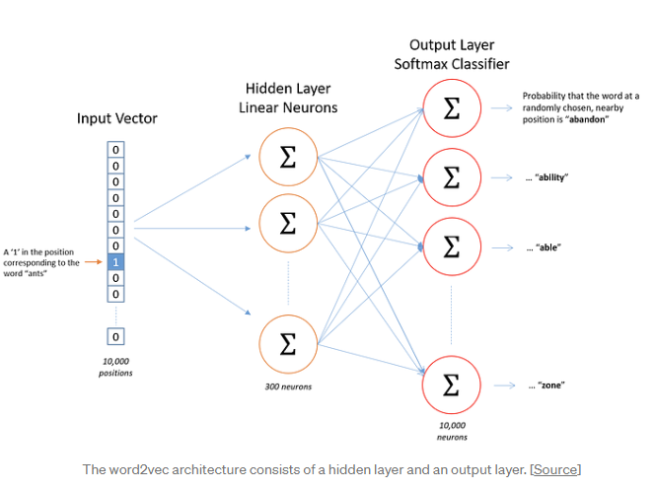
Transformer: Embedding
Blog of Alammar

Slide 14
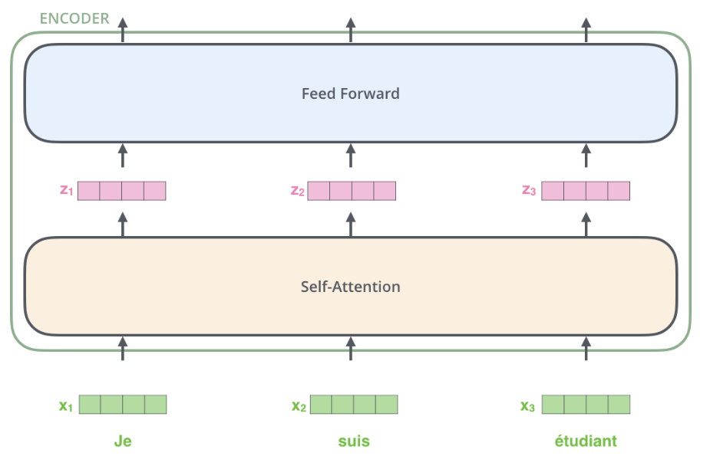
Transformer: Encoder
Blog of Alammar

Slide 15
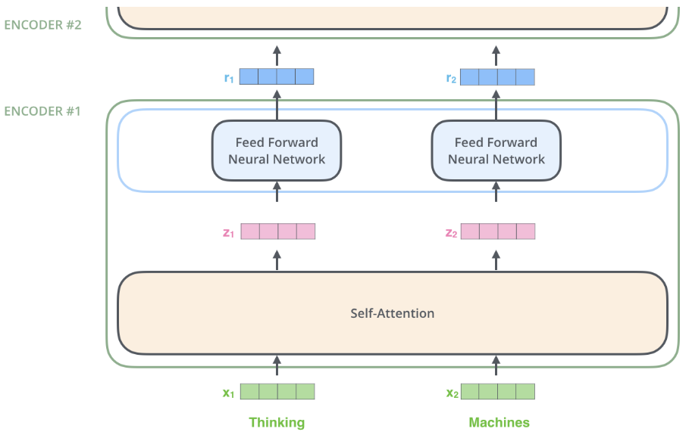
Transformer: Encoder
Blog of Alammar

Slide 16
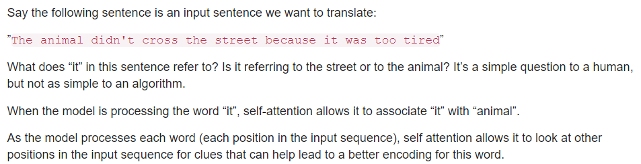
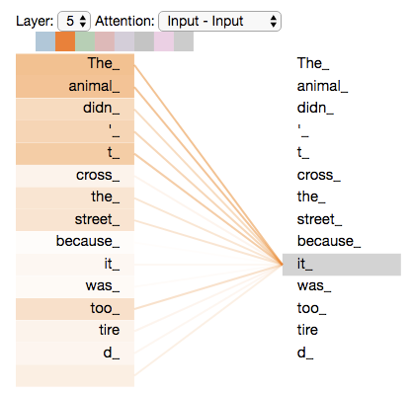
Transformer: Self-attention
Blog of Alammar

Slide 17
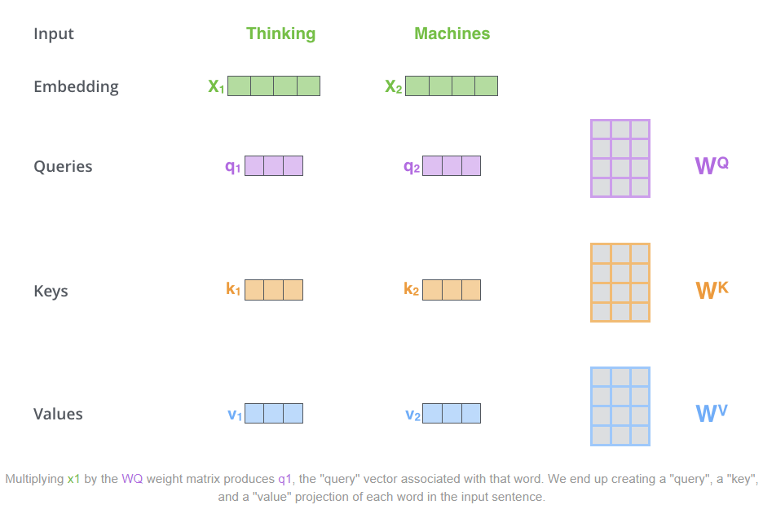
Transformer: Self-attention
Blog of Alammar

Slide 18
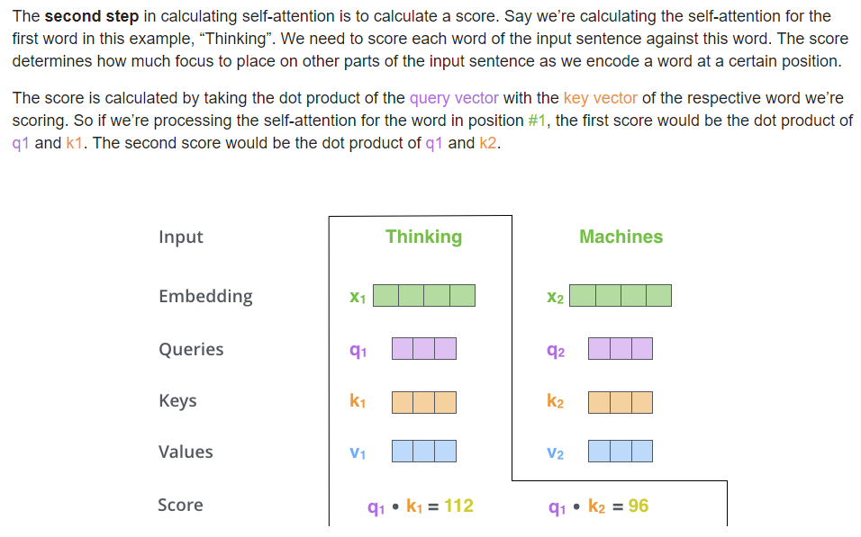
Transformer: Self-attention
Blog of Alammar

Slide 19
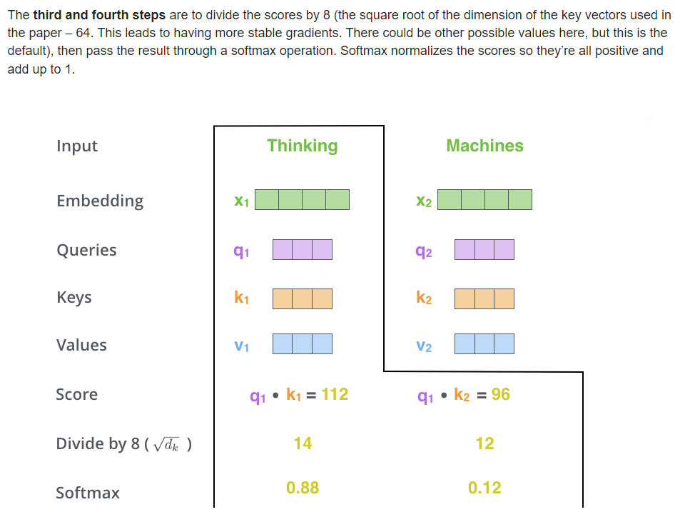
Transformer: Self-attention
Blog of Alammar

Slide 20
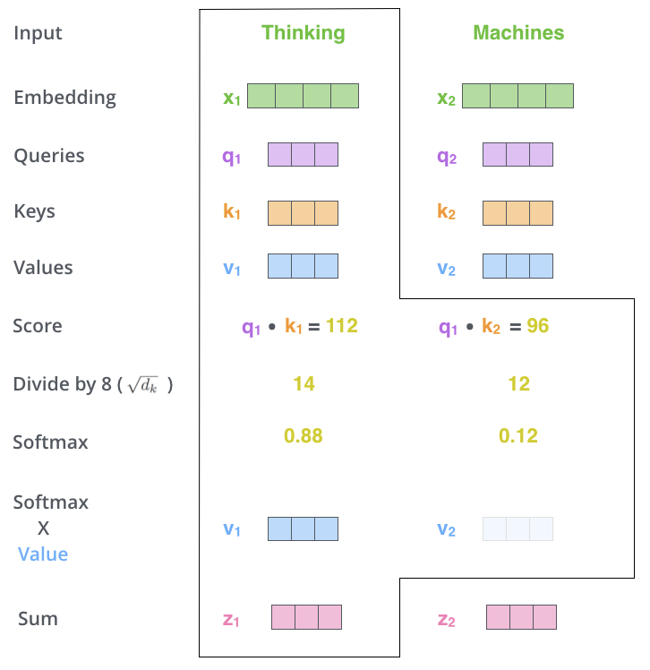
Transformer: Self-attention
Blog of Alammar

Slide 21
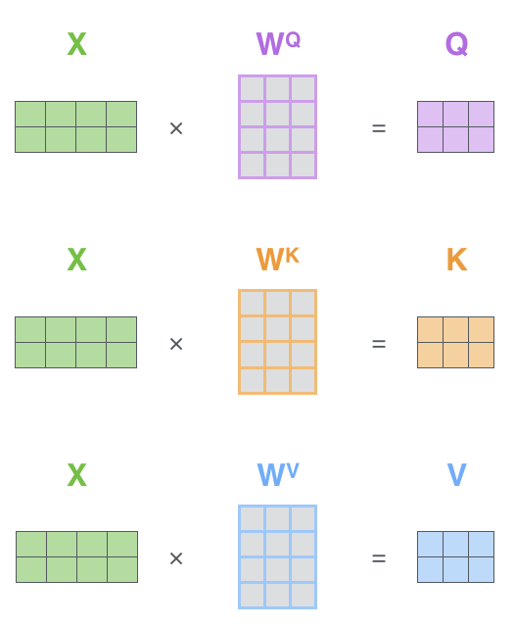
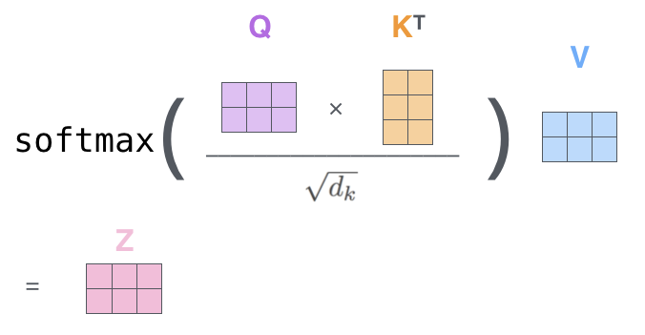
Transformer: Details for self-attention
Blog of Alammar

Slide 22
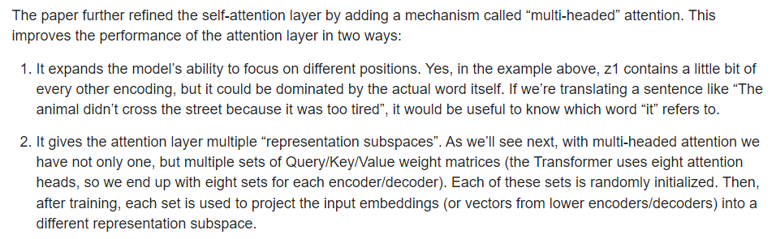
Transformer: Multi-headed attention
Blog of Alammar

Slide 23
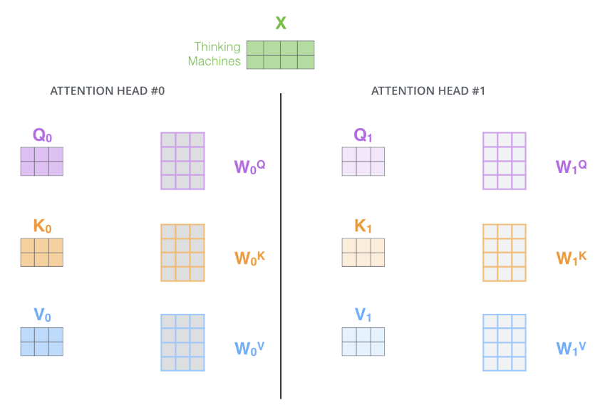
Transformer: Multi-headed attention
Blog of Alammar

Slide 24
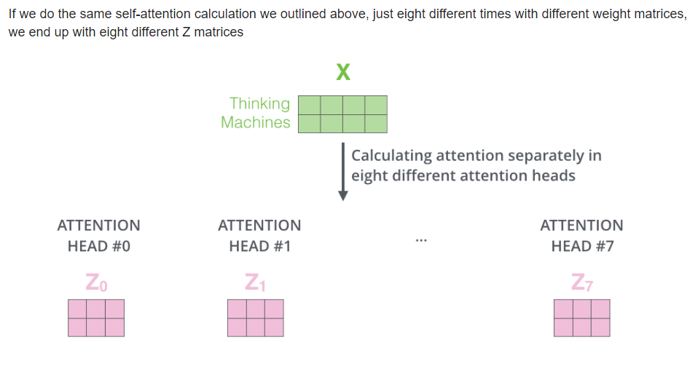
Transformer: Multi-headed attention
Blog of Alammar

Slide 25
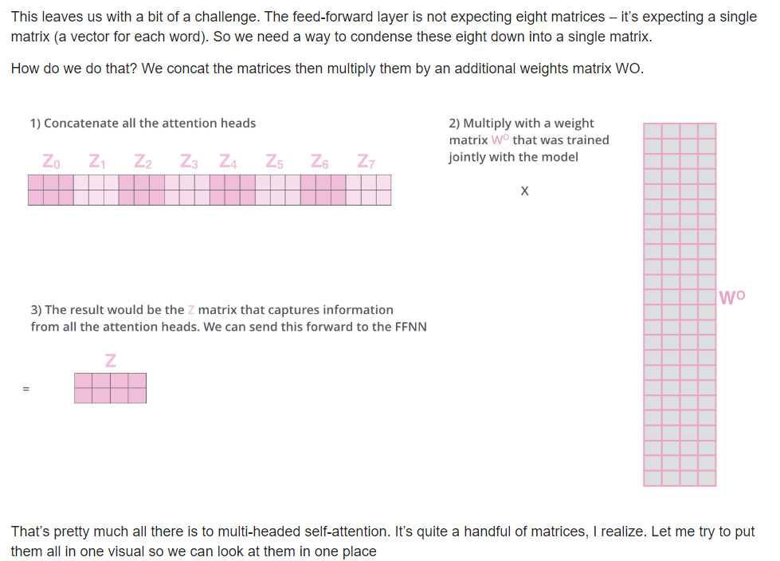
Transformer: Multi-headed attention
Blog of Alammar

Slide 26
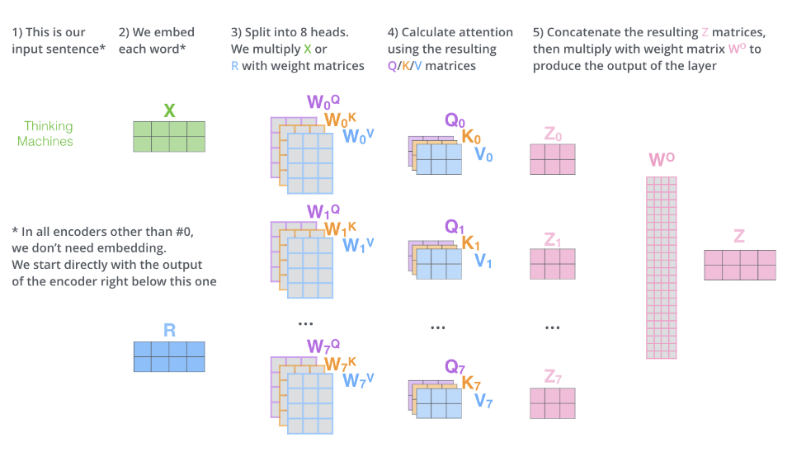
Transformer: Multi-headed attention
Blog of Alammar

Slide 27
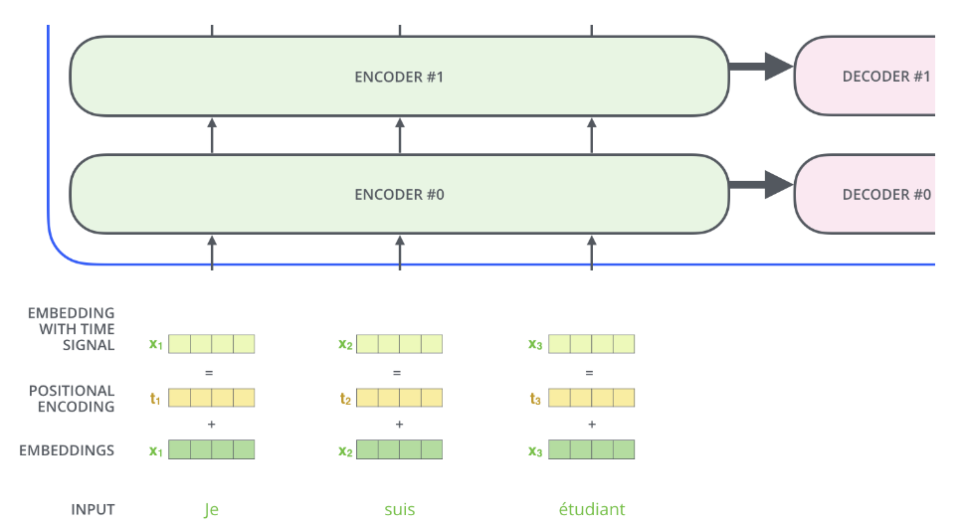
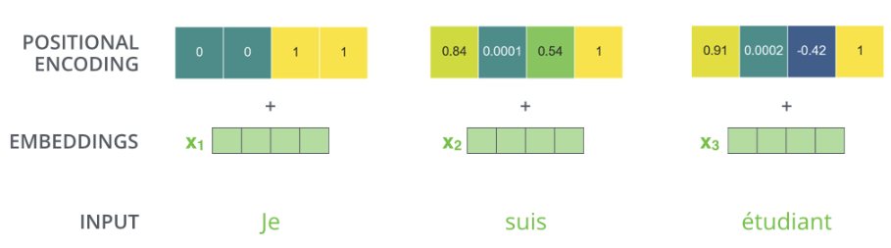
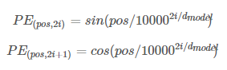
Transformer: Positional Encoding
Blog of Alammar

Slide 28
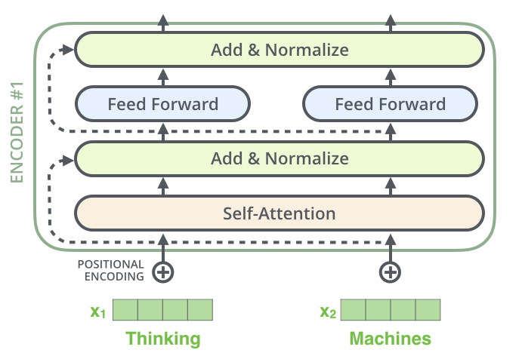
Transformer: ResNets
Blog of Alammar

Slide 29
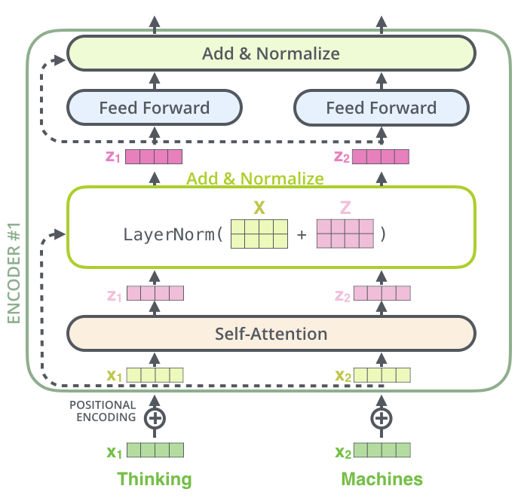
Transformer: Layer-Norm
Blog of Alammar

Slide 30
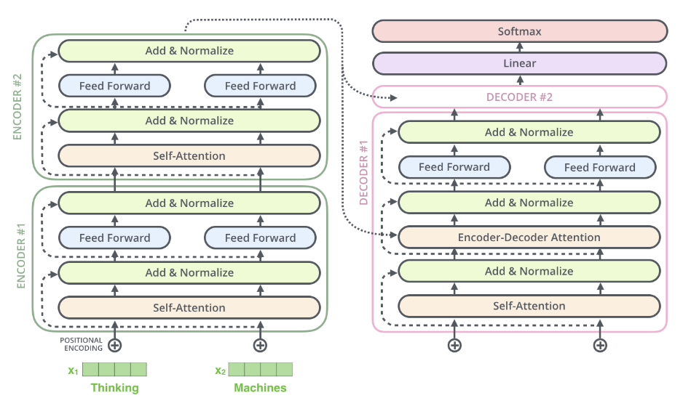
Transformer
Blog of Alammar

Slide 31

Transformer: Decoder
Blog of Alammar

Slide 32

Transformer: Decoder
Blog of Alammar

Slide 33
Transformer: Decoder
Blog of Alammar

Slide 34
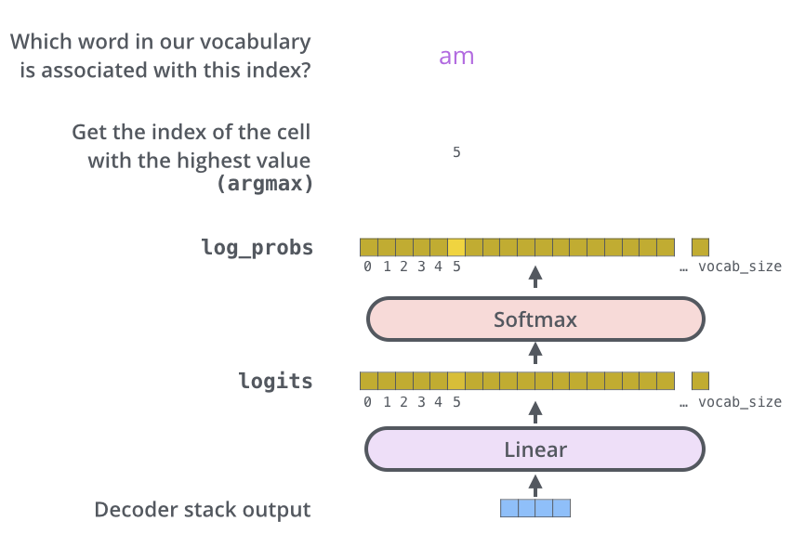
Transformer: Linear & Softmax
Blog of Alammar

Slide 35
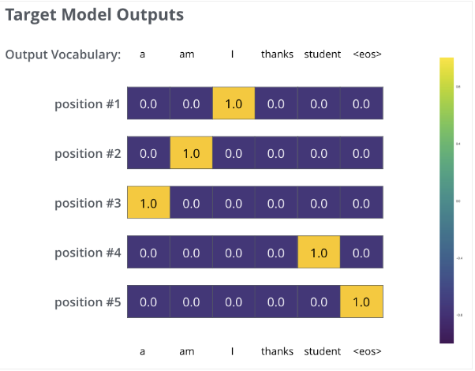
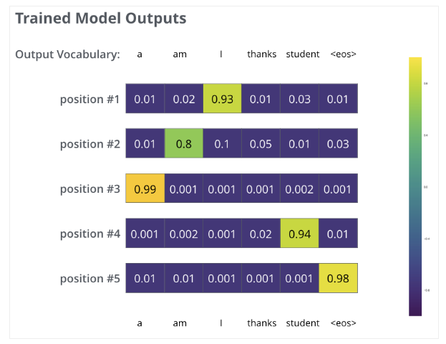
Transformer: Linear & Softmax
Blog of Alammar

Slide 36

Thank you for your attention!

